Slide 1

Social Engineering

Slide 2


Who am I ?
Name : Adeladay(AD)
Job Title: Sr Officer IT-Security and Awareness
Education: BSC In Computer Science
Experience and Cert : 6 yr +, CCNA, CompTIA A+ NSE1 And NSE2
Hobbies: Hacking Game Like CTF

Slide 3

01
What is social engineering
02
Why Social Engineering
Table of contents
03
Types of SE
04
Mitigation
05 Demo

Slide 4
01
What is Social Engineering

Slide 5


SE
is the art of manipulating people into performing actions of divulging confidential information. This technique manipulate human feelings, such as curiosity or fear to carry out schemes and draw victims into their traps.

Slide 6
Reconnaissance
Hook
Life cycle
Exit
Play
The attacker gathers information about the target, such as their name, job title, and contact information
The attacker establishes contact with the target and builds rapport.
The attacker achieves their goal and escapes without being detected
The attacker manipulates the target into performing a desired action, such as clicking on a malicious link or revealing

Slide 7

02
why Social Engineering

Slide 8

Them
Us
It is relatively easy
It is very effective
It is scalable……
According to Firewalltimes 98% of cyber-attacks in 2022 involves some form of social engineering.

Slide 9

03
Types of Social Engineering

Slide 10

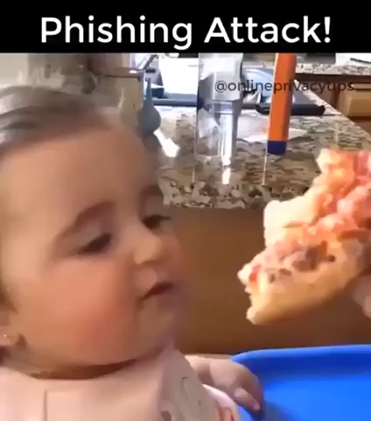
Phishing

Slide 11

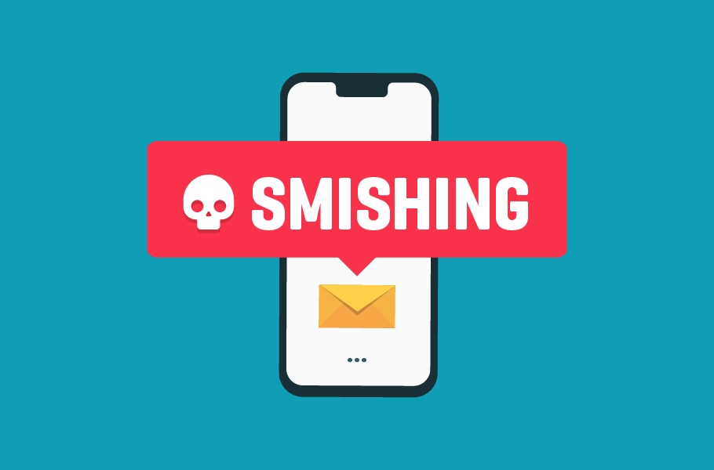
smishing
o text and instant messages faster than emailple respond people respond to text and instant messages faster than emailto text and instant messages faster than email

Slide 12
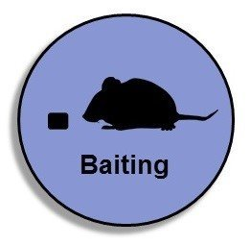
Baiting
Baiting uses a false promise to pique a victim’s greed or curiosity

Slide 13
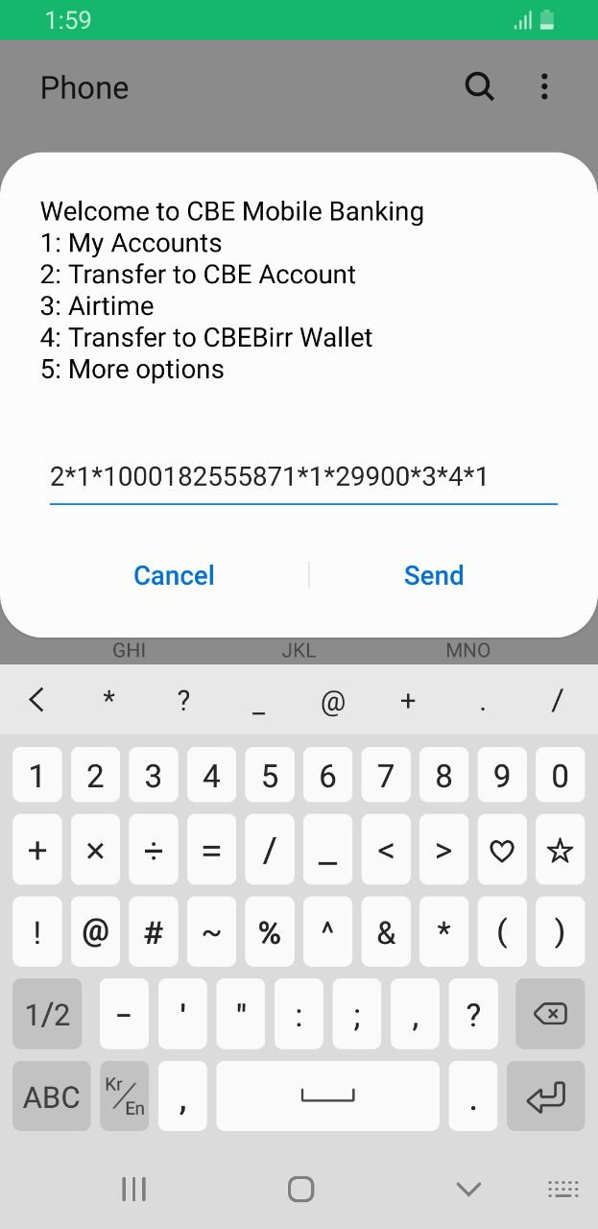

VISHING
Real Attack ET

Slide 14
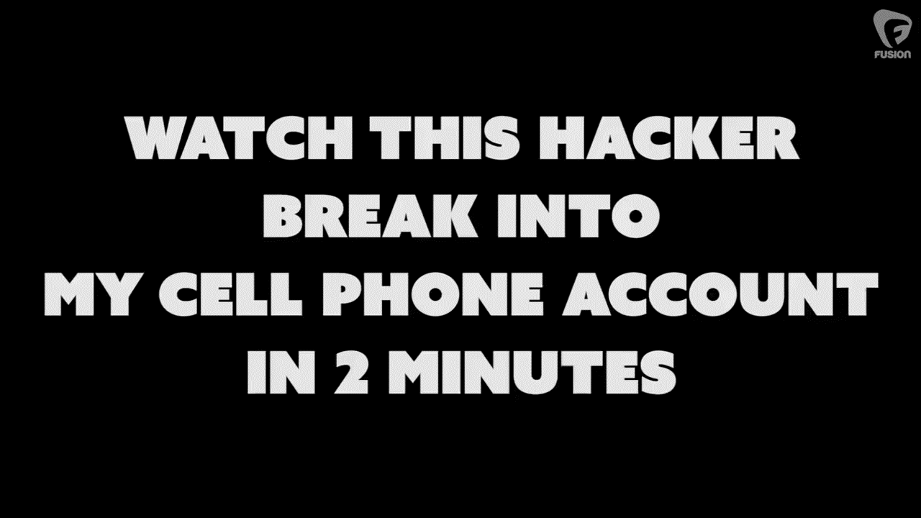

VISHING…

Slide 15
Scareware
In Scareware social engineering techniques, victims being bombarded with false alarms and fictitious threats.

Slide 16


Honey Trap
The perpetrator pretends to be romantically or sexually interested in the victim and lures them into an online relationship.

Slide 17

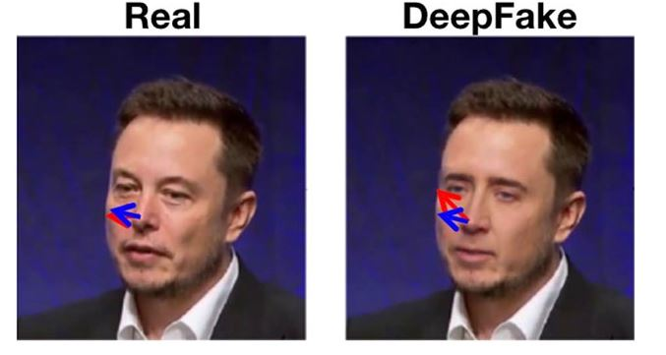
Deep Fakes
Deep fakes are synthetic media that have been digitally manipulated to replace one person's likeness convincingly with that of another

Slide 18
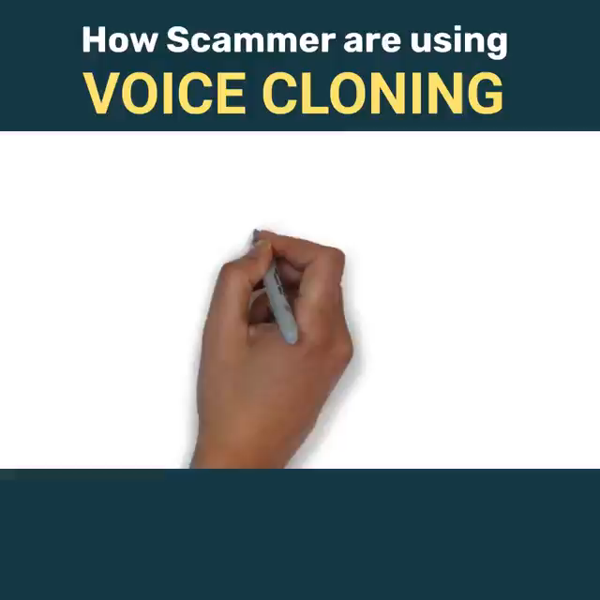
Deep Fakes

Slide 19

04
Mitigations

Slide 20
Mitigations
1 Educate the weakness, reward the positive
2 use technology to safeguard not as the savior
3 Actionable policies
4 Realistic Testing ....from the top down

Slide 21
Demo

Slide 22
Thanks
The End!!!

